Slide 1
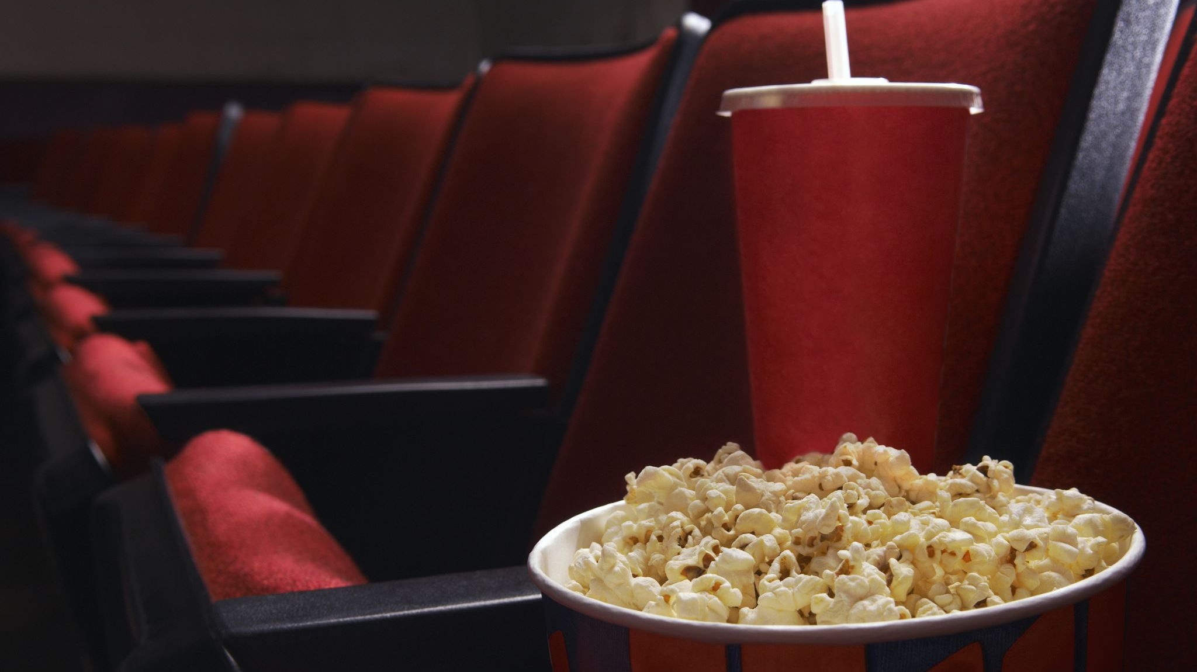
Movie Verse
By – Avanith kanumaralapudi
Duy le
Lakshmi pranathi Vutla
Kareem Duwaji

Slide 2

Introduction
Inspiration and Objectives
Inspiration: This project was inspired by the love of movies and the desire to provide a comprehensive platform for movie enthusiasts.
Objectives:
Discover Movies: Allow users to explore movies by genre, rating, or title.
Community Building: Create a forum where users can discuss, review, and share opinions about their favorite films.
Data Insights: Leverage visualizations to show trends like gross revenue by genre.
Personalization: Provide tailored movie recommendations based on user preferences and ratings.

Slide 3
Features Overview
Movie Search and Filtering:
Users can search for movies and refine results by genre.
A clean and intuitive search bar allows quick navigation.
Discussion Forum:
Users can participate in discussions and post topics about their favorite movies.
Features for adding and viewing comments to encourage community interaction.
User Reviews:
Users can write detailed reviews, rate movies, and share their thoughts with the community.

Slide 4
Features Overview
Movie Recommendations:
Personalized recommendations are generated using collaborative filtering techniques.
Tailored to users' viewing and rating history.
Statistics Dashboard:
Visualizes trends, such as total gross revenue by genre.
Interactive charts make data exploration engaging and easy.

Slide 5
Technical Architecture
Technologies Used:
Frontend:
HTML, CSS, JavaScript (Chart.js) for responsive design and interactive elements.
Backend:
PHP and Flask (Python) for handling server-side operations and APIs.
Database:
MySQL for storing data related to movies, users, reviews, and genres.
Visualization:
Chart.js for creating dynamic and interactive graphs.

Slide 6
High-Level Workflow
Frontend:
Users interact with the web interface to perform tasks like searching for movies or posting reviews.
Backend:
The PHP-based backend handles requests, connects to the database, and fetches data.
API Integration:
A Flask-based recommendation engine processes user data for personalized movie suggestions.
Database:
All data, such as user reviews, movie details, and genre statistics, are stored in a MySQL database.

Slide 7
Features Demonstrated
Search and Filter:
Users can search movies and filter by genre.
Recommendations:
Popular movies displayed dynamically.
Navigation:
Easy access to pages like Discussion, Statistics, and Logout.

Slide 8
Detailed Features
Movie Search and Filtering:
Dynamic Search:
Allows users to find movies quickly by entering keywords in the search bar.
Filters by genre ensure users find movies matching their preferences.
Discussion Forum:
Interactive Community Space:
Users can initiate and engage in discussions about trending movies.
Comments and replies enhance engagement and foster community.
User Reviews:
Rating and Review System:
Simple interface for users to rate movies from 1 to 5 stars.
Reviews are visible to other users, enriching the discussion.

Slide 9
Recommendation System
User Input:
Based on ratings and reviews provided by users.
Collaborative Filtering:
Suggests movies liked by users with similar tastes.
Dynamic Updates:
Recommendations evolve as users provide more feedback, ensuring they remain relevant and personalized.

Slide 10
Key Challenges
Integration of Technologies:
Combining PHP and Flask seamlessly for dynamic functionality.
Managing consistent data flow between the frontend and backend.
Optimizing Recommendation System:
Building a collaborative filtering algorithm that performs well with limited user data.
Handling Large Datasets:
Managing database queries efficiently to ensure low latency for searches and recommendations.
Responsive Design:
Ensuring the platform is accessible on all device types, including desktops and mobiles.

Slide 11

Thank You
Questions?
Feel free to share your feedback or suggestions.

